Slide 1
Planning and Developing Written Business Messages

Slide 2
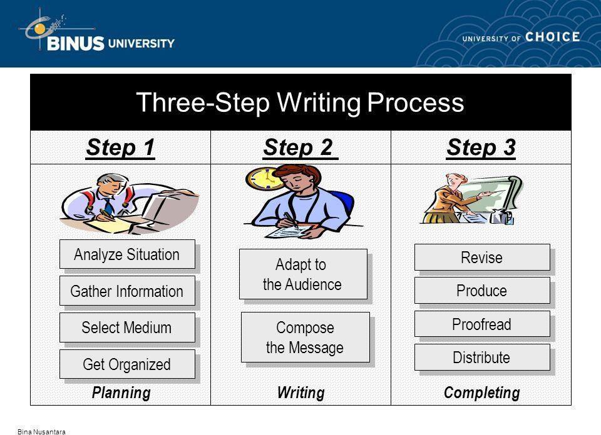
Business Writing

Slide 3

PLANNING
1. Analyzing the Situation

Slide 4




Analyzing the Situation
Who is the audience?
What is the purpose?

Slide 5
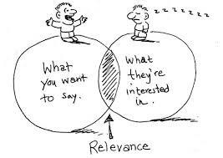
Analyze Situation- Understanding Audience
Chapter 1 - 7

Slide 6
Profile Your Audience
Identify the primary audience
Identify your most important audience
Determine the size of your audience
A report for wide distribution requires a more formal style and organization, than one directed to three or four people in your department
Determine the composition of the audience
Look for common grounds that tie audience members together across differences in culture, education, status, or attitude. Include content/example(s) that they can comprehend

Slide 7
Profile Your Audience
Gauge your audience’s level of understanding
If audience members share your general background, they will understand your material without difficulty. If not, you must educate them
Project your audience’s expectations and preferences
Will members of your audience expect complete details or will a summary of the main points suffice? Do they want an e-mail or will they expect a formal letter?

Slide 8

2. Gathering Information
With a clear picture of your audience, your next step is to
gather information
To get started, try some informal methods, such as considering the audience’s perspective; what they need to know? how much information should be delivered? Focus on psychographics analysis
Chapter 1 - 11

Slide 9
3.Selecting right Medium
A communication medium is simply "how" your message is sent to the receiver. It is often referred to as the communication channel.

Slide 10








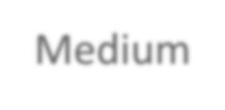
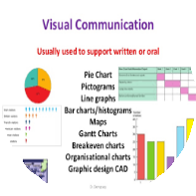

Selecting the right medium
oral
written
Medium
Visual
electronic

Slide 11



By giving communicators or audience the ability to see, hear, and react to each other, traditional oral communication is useful for encouraging people to ask questions, make comments, and work together to reach a consensus or decision.
Of course, if you do not want a lot of questions or interaction, oral channel can be an unwise choice.
▶ Conversations
▶ Interviews
▶ Speeches
▶ Presentations
▶ Meetings

Slide 12





Memos
Letters
Reports
Proposals

Slide 13

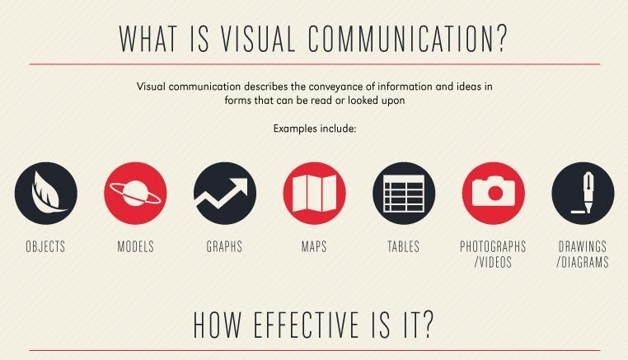
Communicate Fast
Clarify Complexity

Slide 14
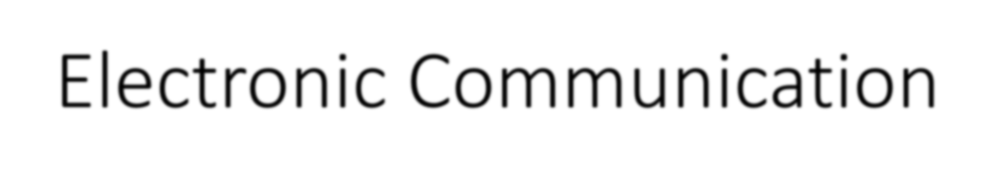

Oral Media
Written Media
Visual Media

Slide 15
Factors in Choosing the Appropriate Medium
This is a medium's ability to convey a message without difficulties. i.e., email or oral
Medium richness
Your choice of medium governs the style and tone of your message
For example, a letter is likely to be perceived as a more formal gesture than an instant message (IM)
Message formality
Each medium has its own limitations
Medium limitations
For instance, IM is perfect for communicating simple, straightforward messages, but it is ineffective for sending complex information
Chapter 1 - 18

Slide 16
Some mediums establish a connection with the audience faster than others, so choose wisely if your message is urgent
Urgency
If a message is not urgent, choose a medium that allows people to respond at their convenience
Cost
Choose a medium that is relevant to the situation and is cost-effective
Audience preferences
Make sure to consider which medium your audience prefers
Analyse your alternatives accordingly to suit your audience needs

Slide 17
4.Organizing your Ideas
Make sure to arrange your content accordingly. The organization is crucial in order to compose a comprehensive document
Content: Short? Long? It will be based on your initial analysis of the situation

Slide 18
WRITING
Once you have clear direction of the document/message, now it is time to:
adapt to your audience – your choice of words should match your audience
compose your message by using the relevant approach, creating effective sentences, and developing coherent paragraphs

Slide 19
COMPLETING
Revise your message to make sure it is comprehensive (purpose, approach, content and etc.,)
Proofread the final product for typos, and format
Finally, distribute your message

